Slide 1

TOR: The Onion Router
Sanath n upadhyaya
1BM19EC139

Slide 2

Introduction
Decentralized internet is a people-powered kind of internet that makes the web more democratic.
The workings of Tor, a popular tool is discussed here.
The main mission statement of Tor is:
“To advance human rights and freedoms by creating and deploying free and open source anonymity and privacy technologies, supporting their unrestricted availability and use, and furthering their scientific and popular understanding.”

Slide 3
Introduction
Tor works on basically on the Onion Routing Protocol, which is a technique for anonymous communication over the internet.
Tor can help a person anonymize web browsing and publishing, instant messaging and other applications.
Onion Routing aims to defend against traffic analysis, a form of network surveillance that threatens personal anonymity and privacy, confidential business activities and relationships, and state security.

Slide 4
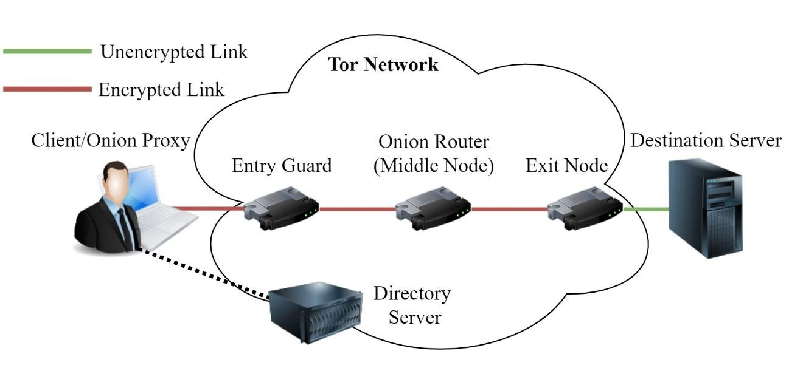
How the Tor Network Works?
The basic element of the network is a Node or a computer with internet connection. There are mainly 3 types of nodes:
Entry Node: The client enters this network first.
Relay Node: The intermediate node, which only knows its previous and next nodes
Exit Node: The final node which relays the data to the destination server
The final component of the Tor network are Directory Servers. The main purpose of these is to
maintain the updates of the Tor nodes.

Slide 5
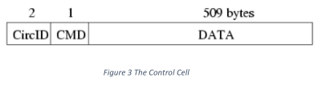

Protocol
Traffic is forwarded along connections in fixed-size cells. Each cell is 512 bytes long, consisting of header and payload.
There are two types of cells, control cells and relay cells.
These have multiple parameters which determines the type of message that is sent.

Slide 6
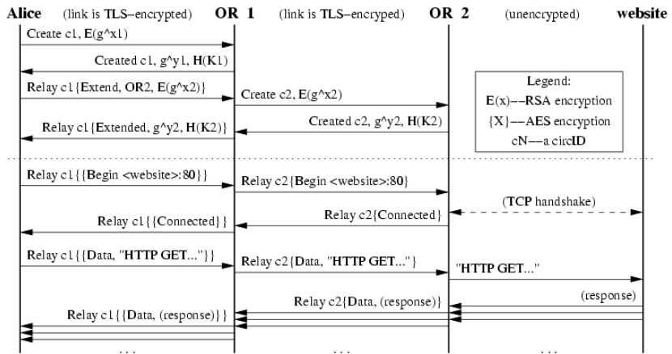
Connection Establishment

Slide 7
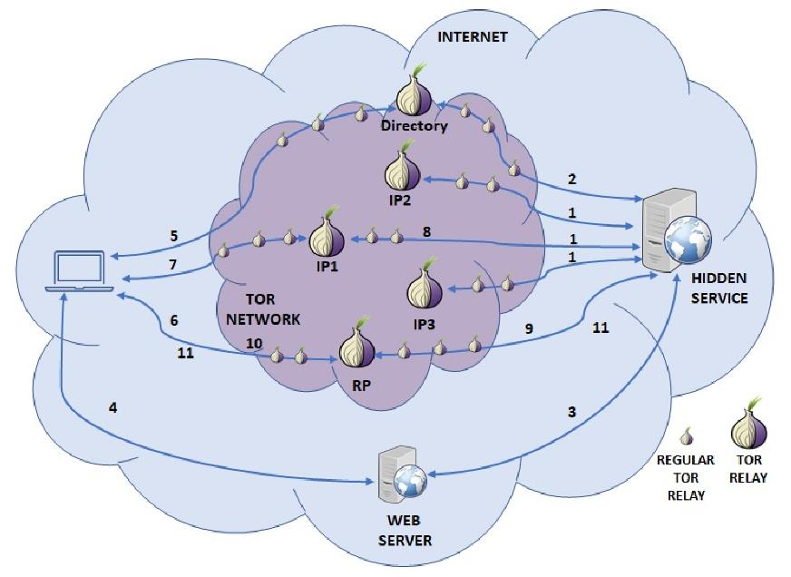
Hidden Services
Tor can also provide anonymity to websites and other servers . Rather than revealing a server's IP address (and thus its network location), an onion service is accessed through its onion address, usually via the Tor Browser.
Since the service is “Hidden” from the normal nodes of the network, this is known as hidden services.

Slide 8
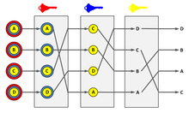


Alternative Protocols
Mix Nets
And many more….!

Slide 9
Conclusion
In this presentation, we discussed how Tor, a very popular routing protocol works .
Tor is a very special protocol which has been successful and has technically been very successful in anonymizing users except for certain type of attacks.
More such decentralized and secure protocols should be adopted in the future for a much more secure and free future.

Slide 10
Thank You!

